Slide 1
Selective-Backprop: USE TITLE
Angela H. Jiang, Daniel L.-K. Wong, Giulio Zhou, David G. Andersen, Jeffrey Dean, Gregory R. Ganger, Michael Kaminsky, Michael A. Kozuch, Padmanabhan Pillai

Slide 2

DNNs are a fundamental building block of applications
Notes:
Over the last decade, deep neural networks, or DNNs have become not only a hot buzzword, but a fundamental buildling block of applications, including AlphaGo, autonmous vehicles, translation systems and medical imaging

Slide 3
Training DNNs is challenging
Resource-Intensive
Models are error-prone
Notes:
Despite this, training DNNs remains challenging. Training is very resource intenstive, sometimes takings weeks or months of expensive GPU-time. And the final models remain error prone.

Slide 4
Labeled Datasets are Getting Larger
ImageNet: 15 million images
OpenImages: 9 million images
Production datasets are often much larger
JFT: 300 million images
click-through data
autonomous vehicle training video
Notes:
One cure for reducing model error is to make ever-larger datasets. Sometimes so large that we cannot train on all the data. This might be in contrast with what you’ve heard, which is that more labeled data is always better. But in practice, we often have more Images than we have time or resources to train with. For instance, most machine learning developers do not train on ImageNet from scratch because it takes too long.
The motivation for this project is that labeled dataset are getting larger. So large, that we often cannot train on all the data. This might be in contrast with what you’ve heard, which is that more labeled data is always better. But in practice, we often have more Images than we have time or resources to train with. For instance, most machine learning developers do not train on ImageNet from scratch because it takes too long. This problem is even more common in industry. While large tech companies have lots of machines, they also have a growing wealth of data. For instance, you’ll never be able to train through all of Google’s click through data

Slide 5
Selective-Backprop
SB selects high-value training examples for DNN model training
SB achieves faster convergence per training example
SB achieves higher converged accuracy
SB is practical
Scalable
Lightweight
Self-paced
Notes:
- By focusing on high-value examples, we are able to reach target accuracies faster
- Also, we show that we are able to guide the network to a better solution to get a higher final accuracy

Slide 6
Introduction
DNN Training Overview
Selective-Backprop Approach
Selective-Backprop Evaluation
Conclusion

Slide 7
Introduction
DNN Training Overview
Selective-Backprop Approach
Selective-Backprop Evaluation
Conclusion

Slide 8
What is a DNN?

Slide 9
Deep neural network (DNN) Inference
.6
.1
.2
.1

Slide 10
Deep neural network (DNN) Training
Class 1

Slide 11
Deep neural network (DNN) Training
Class 3

Slide 12
Deep neural network (DNN) Training
Class 2
Notes:
Weights => Parameter

Slide 13
Why is DNN training slow?

Slide 14
Training cycle is bottlenecked by backwards pass
Notes:
Can we avoid doing the backwards pass so often? What if there are examples that are more surprinsing that teach the ntwork more than others?
Backward pass is w
Shoulnd'hen the network is learning, so you can learn more from surprising examples
Shouldn’

Slide 15
Training cycle is bottlenecked by backwards pass
Notes:
Can we avoid doing the backwards pass so often? What if there are examples that are more surprinsing that teach the ntwork more than others?
Backward pass is when the network is learning, so you can learn more from surprising examples

Slide 16
Training cycle is bottlenecked by backwards pass
Notes:
Can we avoid doing the backwards pass so often? What if there are examples that are more surprinsing that teach the ntwork more than others?
Backward pass is when the network is learning, so you can learn more from surprising examples

Slide 17
Training cycle is bottlenecked by backwards pass
Notes:
Can we avoid doing the backwards pass so often? What if there are examples that are more surprinsing that teach the ntwork more than others?
Backward pass is when the network is learning, so you can learn more from surprising examples

Slide 18
Training cycle is bottlenecked by backwards pass
Notes:
Can we avoid doing the backwards pass so often? What if there are examples that are more surprinsing that teach the ntwork more than others?
Backward pass is when the network is learning, so you can learn more from surprising examples

Slide 19
Training cycle is bottlenecked by backwards pass
Notes:
Can we avoid doing the backwards pass so often? What if there are examples that are more surprinsing that teach the ntwork more than others?
Backward pass is when the network is learning, so you can learn more from surprising examples

Slide 20
Training cycle is bottlenecked by backwards pass
Notes:
Can we avoid doing the backwards pass so often? What if there are examples that are more surprinsing that teach the ntwork more than others?
Backward pass is when the network is learning, so you can learn more from surprising examples

Slide 21
Training cycle is bottlenecked by backwards pass
Notes:
Backwards is typically much slower than forwards
Right now it’s about 2-3x slower on modern GPUs
With inference-optimized hardware, we might see 10x
And with 10x, the backwards pass is going to dictate the speed of training
The forward looking view is that opttimizing backprop is the way you will make training go fast
Say more on 10 X

Slide 22
Introduction
DNN Training Overview
Selective-Backprop Approach
Selective-Backprop Evaluation
Conclusion

Slide 23
Can we select high-value training examples?

Slide 24
How to tell if an example is high-value
Frame decimation, difference detectors, etc
Done before training => not specific to the trained model
Active learning techniques
Doesn’t take advantage of ground truth
Compare output of inference to ground truth (e.g., loss)
Specific to current state of this model
Notes:
There’s a body of literature that takes a dataset, and tries to distill it into the most diverse and representative set of examples
There’s another field which recognizes that labeling is expensive, typically done by a human. There are techniques to find high impact images to label. For instance, one might decide to label examples in which the network is the least confident in
They were trying to avoid a different expensive process, which is labeling their data. This is different from our problem w
As opposed to other techniques that say if it’s generally useful, our technique will evaluate how this model at its current stage of training performs on the eample

Slide 25
Selective-Backprop (SB) approach
Forward propagate example
through the network
Calculate usefulness of
backpropping example
based on its accuracy
“Flip a coin” to determine if
we should backprop
Notes:
Be more explict about the connection between surprisingness and probability that you selecrt it
We come up with this probability so that images that we have the most to learn from are most likely to be backpropagated

Slide 26
Selective-Backprop’s Usefulness Metric
Likelihood of backprop is proportional to loss
Scalable
Lightweight
Self-paced
Notes:
Properties: Self regulating

Slide 27
Selective-Backprop’s Usefulness Metric
= [0, 0, 1]
= [0.1, 0.3, 0.6]
= 0.509
= 0.509
Notes:
Where the size of the vector corresponds to the number of classes we have
We denote the class the example belongs to, with a 1 at that index
Strength of our belief, normalized to sum up to one
We’re choosing to backprop this thing because we’re currently bad at it. Of course, this may change over the course of training.

Slide 28
Introduction
DNN Training Overview
Selective-Backprop Approach
Selective-Backprop Evaluation
Conclusion

Slide 29
Experimental setup

Slide 30
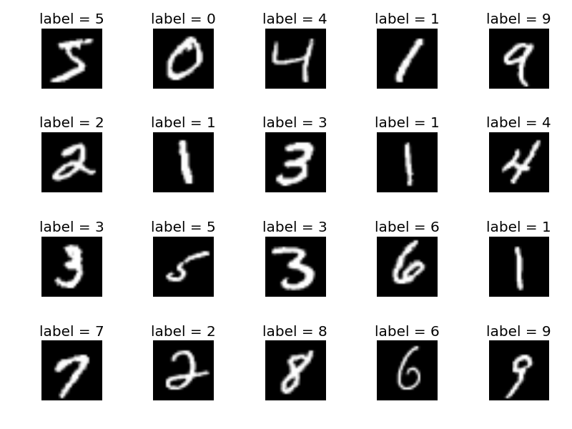
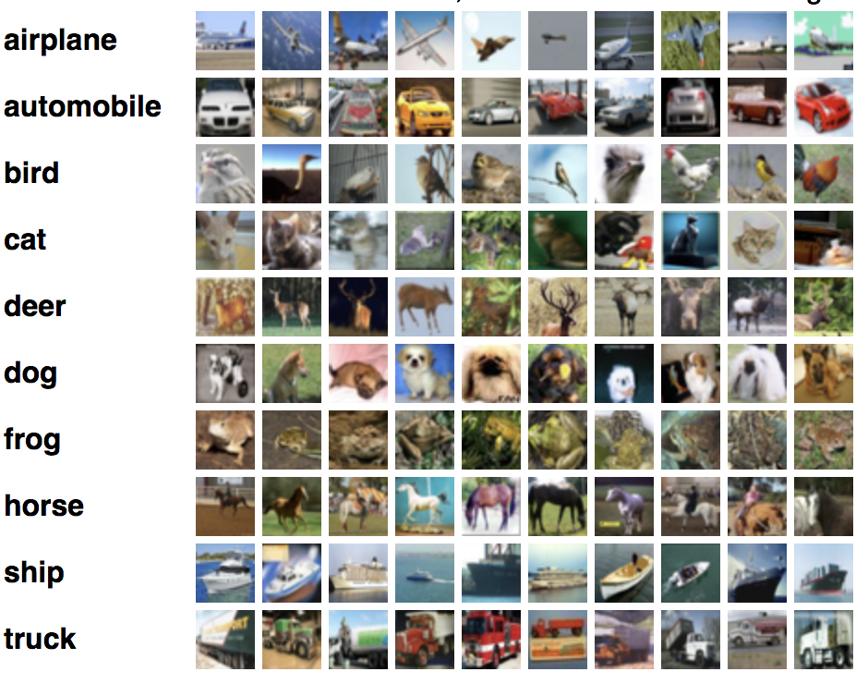
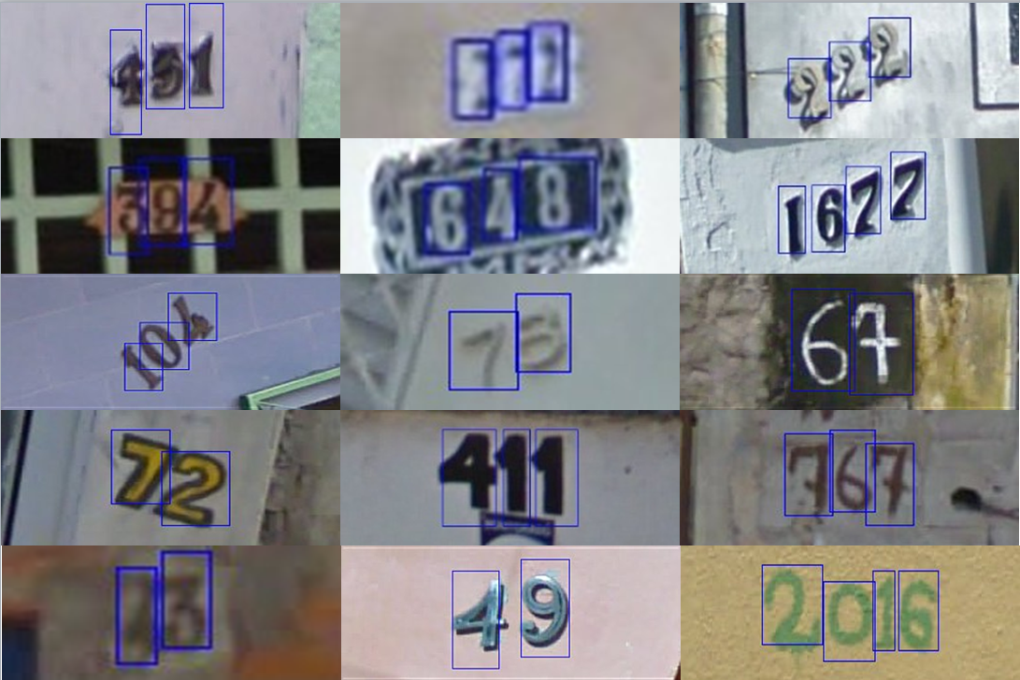
Datasets
MNIST
CIFAR10
SVHN
50,000 Training Images
60,000 Training Images
604,388 Training Images
Notes:
Update SVHN # training examples

Slide 31
Approaches
Baseline
No filtering
Katharopoulos18
Static selectivity
Selective-Backprop (Us)

Slide 32
How does SB perform?

Slide 33
SB on MNIST gets 2.45% err. w/ 66% fewer backprops
66% fewer backprops
46% error decrease
Notes:
Baseline error: 2.45%
SB error: 1.33%
Percent decrease: 46%
Baseline iterations: 0.96
SB Backwards: 0.32
SB Forwards: 1.62
Backwards reduced: 66.67%
Forwards increased: 68.75%
Update titles

Slide 34
SB on CIFAR10 gets 9.21% err. w/ 22% fewer backprops
22% error decrease
40% fewer backprops
Notes:
Baseline error: 9.21%
SB error: 7.22%
Error decrease: 22%
Baseline iterations: 12.6
SB Backwards: 7.53
SB Forwards: 28.4
Backwards reduced: 40.24%
Forwards increased: 125.4%
Kath error: 10.04%
Error decrease: 10

Slide 35
SB on CIFAR10 decreases error by 28% compared to Kath18
28% error decrease
Notes:
Baseline error: 9.21%
SB error: 7.22%
Error decrease: 22%
Baseline iterations: 12.6
SB Backwards: 7.53
SB Forwards: 28.4
Backwards reduced: 40.24%
Forwards increased: 125.4%
Kath error: 10.04%
Error decrease: 10

Slide 36
Why does SB perform well?
Notes:
Attribution anal- yses showing that Selective-Backprop’s benefits derive from its dynamic selectivity, loss-proportional selection probabil- ity, and choice to not reweight losses.

Slide 37
SB on CIFAR10 focuses on hard examples
= [0, 0, 1]
= [0.1, 0.3, 0.6]
= 0.6
Notes:
Give overview in a couple of sentences. Then explain in detail
SB is sacrificing confidence on earlier examples to have confidence in examples where it’s less confident
In terms of final accuracy, there’s no reward for excess confidence. If you’re over 50% confident, you can make it higher, but it won’t improve your test accuracy
But with low confidence examples, increasing your confidence has high impact on test accuracy
On the second graph, explain why you’re better all the time
FIND REPLACEMENT FOR EASY AND HARD
Spend more time on background, How does backprop work, why is it slower
One line about what training is
Many times over a dataset
Softmax output => output
Experimental setup, add more, get training, axes are well-understood, etc.
Three graphs side by side, too small, do 2 X 1
Say more about Kath18 if you’re going to show it. Potentially drop Other approaches: devote a whole slide to each to them if it’s gonna be understood
1/3 on background, fewer graphs!! To explain well
Define backprop
basically

Slide 38
SB on CIFAR10 focuses on hard examples
= [0, 1, 0]
= [0.1, 0.3, 0.6]
= 0.3
Notes:
PRACTICE
SB is sacrificing confidence on earlier examples to have confidence in examples where it’s less confident
In terms of final accuracy, there’s no reward for excess confidence. If you’re over 50% confident, you can make it higher, but it won’t improve your test accuracy
But with low confidence examples, increasing your confidence has high impact on test accuracy
On the second graph, explain why you’re better all the time

Slide 39
SB on CIFAR10 focuses on hard examples
Notes:
PRACTICE
Give overview in a couple of sentences. Then explain in detail
SB is sacrificing confidence on earlier examples to have confidence in examples where it’s less confident
In terms of final accuracy, there’s no reward for excess confidence. If you’re over 50% confident, you can make it higher, but it won’t improve your test accuracy
But with low confidence examples, increasing your confidence has high impact on test accuracy
On the second graph, explain why you’re better all the timeoverspecializing to some examples take the 20 % rthat you do the least well on, how well do you do on them

Slide 40
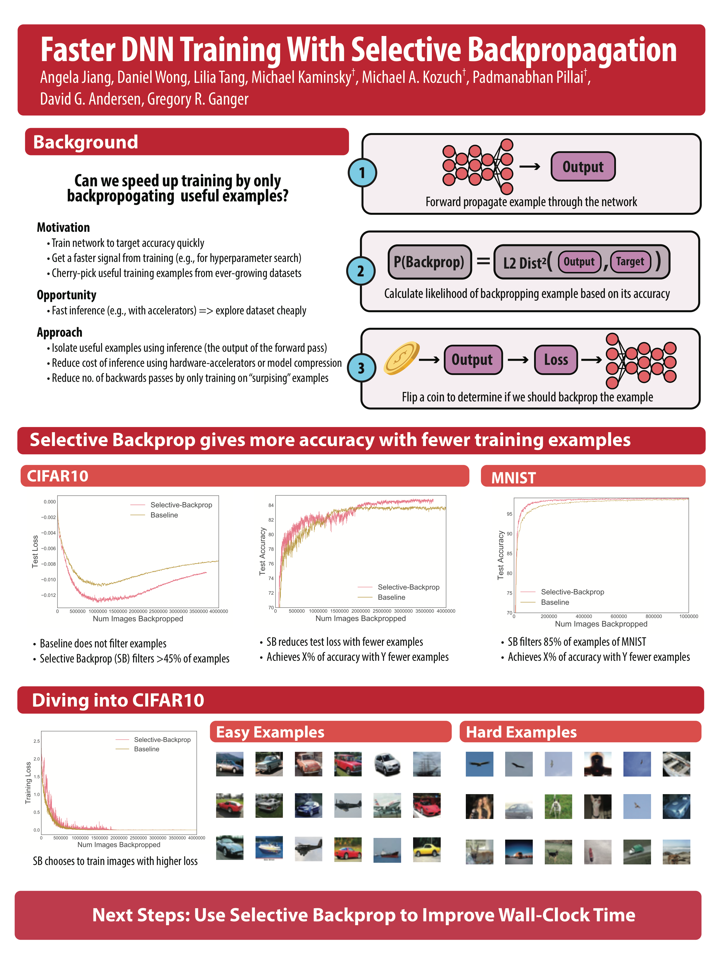
Which images are easy?
Notes:
They consist of easy to classify images, mostly of cars

Slide 41
Which images are hard?
Notes:
They consist of objects from unconvential angles, as well as a lot of small birds with a blue background, likely because it’s hard to know if it’s a ship or a plane.
Use woman in truck as a lead in for the next slide. By focusing on it, we might get worse at understanding trucks

Slide 42
Is SB robust to label error?

Slide 43
SB is robust to label error in SVHN
Notes:
1.4048, 0.360544 = 74.3% fewer backward passes
55% more forwards passes

Slide 44
SB is robust to small amounts of label error
0.1% Randomized
1% Randomized
10% Randomized
Notes:
1.4048, 0.360544 = 74.3% fewer backward passes
55% more forwards passes

Slide 45
Introduction
DNN Training Overview
Selective-Backprop Approach
Selective-Backprop Evaluation
Conclusion

Slide 46
Comparison to related work
Importance sampling to reduce iterations
Gao et al. 2015; Johnson & Guestrin 2018; Loshchilov & Hutter 2015; Katharopoulos & Fleuret 2018
Sacrifices final accuracy
Importance sampling to improve accuracy
Bengio et al. 2009; Kumar et al. 2010; Alain et al. 2015; Jiang et al. 2015; Katharopoulos & Fleuret 2017; Jiang et al. 2018; Ma et al. 2017; Ren et al. 2018
Does not simultaneously target and analyze training speedup
Notes:
Selective-Backprop is part of a class of mechanisms called importance sampling, where you sample the important examples from your training dataset. Importance sampling is used speed up DNN training, and to improve final accuracy. Notably, SB does both, while being practical and easy to use.

Slide 47
Future work
Selective-Backprop to reduce wall-clock time
Selective-Backprop to isolate mislabeled examples and outliers
Selective-Augment
Notes:
Today, I showed how SB reduces training iterations needed to achieve a target accuracy. However, this comes at the cost of additional forward passes. In the future, we’d like to show the wall-clock savings

Slide 48
Takeaways
Selective-Backprop trains on surprising examples
Achieves target accuracies with fewer backprops
Achieves 2.45% on MNIST with 67% fewer backprops
Achieves 9.21% on CIFAR10 with 40% fewer backprops
While improving final target accuracy
Achieves 1.33% on MNIST, 46% relatively lower error
Achieves 7.22% on CIFAR10 with 22% relatively lower error
SB is practical and easy to use
Notes:
Add open sourc
https://arxiv.org/abs/1603.02839

